Slide 1
ISD 521
Project Presentation
Team 17: Mechatronics and Embedded Systems
Brendan Miller, Namitha Elsa John, Michelle Mastronardi, Skyler Do

Slide 2

Stakeholder Persona and Needs
Our Persona is a senior research scientist named Dr. Emma Wright. Dr. Wright leads a research team at a prominent university lab focused on genetic research and development of new therapies.
involves repetitive and precise tasks such as pipetting, sample preparation, and analysis
a focus on efficiency and throughput.
Her pain points lead back to the repetitive tasks involving pipetting and moving tubes/plates for sample preparation or downstream analysis
Time-consuming
cause physical strain
take away much needed manpower
often suffer from human errors
Dr. Wright also expresses a strong interest towards advanced technology in research innovation especially if they show benefits in efficiency and throughput while balancing budget constraints.

Slide 3
Translation to Requirements
Lab Productivity (“I want the solution to improve lab productivity”)
Solution Performance (“I want the solution to perform to a high standard”)
Solution Integration (“I want the solution to work with existing tool processes and personnel”)
Safety and Comfort (“The solution should be safe to work with and pleasant to work alongside”)
Solution Operation (“I want the solution to be easy to operate”)
Maintenance and Lifetime (“The solution should require minimal maintenance and perform well over its lifetime”)

Slide 4
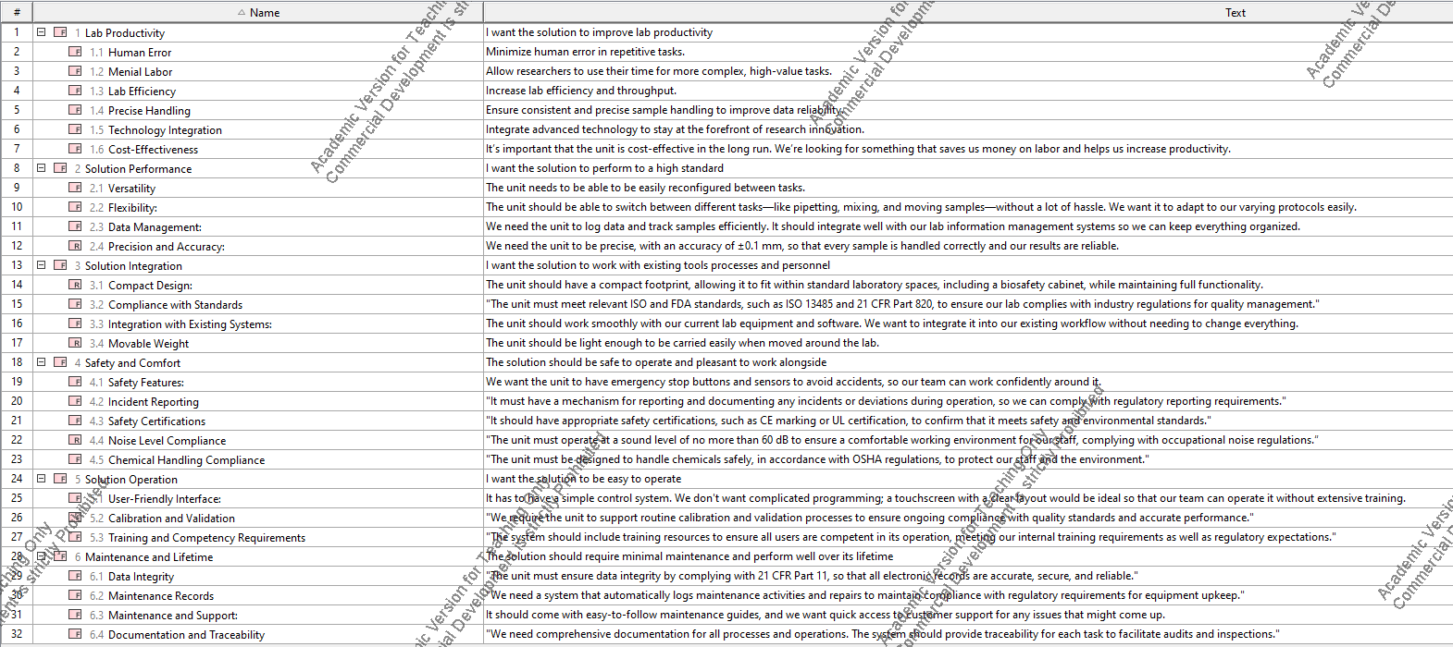
Expanded Requirements

Slide 5
Measures of Effectiveness
Overarching Requirement | MOE | Justification for requirement
Lab Productivity | Time saved, the hours lab staff can now dedicate to other activities | Arguably the system’s most important metric. As a system designed to reduce the workload of lab staff, if the system creates more work for the lab staff it will be considered a failure
Solution Performance | Placement accuracy, measured as incidents of error per 100 tasks completed | A measure of how well the system performs, useful for understanding the quality of the system as a whole
Solution Integration | Functional requirement, necessitates proper interfacing with other lab equipment and operator | The system will not be used in isolation, so it is important that it works well with existing workflows and equipment to support overall lab operations and objectives.
Safety and Comfort | Sound level, the sound disturbance the solution will create during operation | The system will operate in an environment with other people, so it shouldn’t be irritating to work with or around.
Solution Operation | Functional requirement, subjective to the lab staff’s perception of the ease of use of the solution. | The system will be used by lab staff, and should be intuitive to interact with and operate for maximum efficiency.
Maintenance and Lifetime | Weight, the solution weight in case it needs to be moved for maintenance and or repairs throughout its lifetime. | The system as a piece of the lab needs to be able to be moved around, so excessive weight should be avoided.

Slide 6
Technical Decisions: Solution Functionality
Solution will perform 2 main functions:
Pick and place
Pipetting
Both functions derived from stakeholder needs

Slide 7
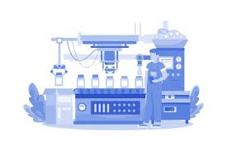
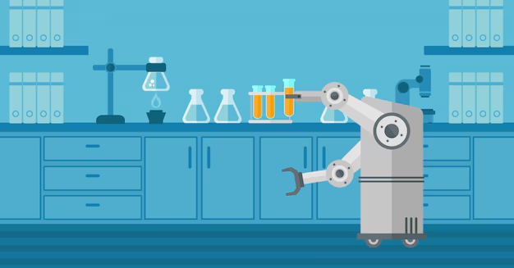
Solution Brainstorming
Options that were considered:
Liquid Handling Workstation
  Designed for pipetting/mixing/dispensing with high precision and throughput using gantry
  Large space requirements, high cost
Pneumatic Pick-and-Place System
  Use suction or grippers to move tubes, vials, or plates
High-throughput Screening System
  Customized for large-scale experiments, combining liquid handling and pick/place
  Highly complex, expensive
Manual Labor
  Hire external staff to perform lab activities
Robotic arm
  Small footprint, able to integrate with existing equipment. Capable of both liquid handling and pick/place operations.
  Flexible and easy to program, lower complexity and development time

Slide 8
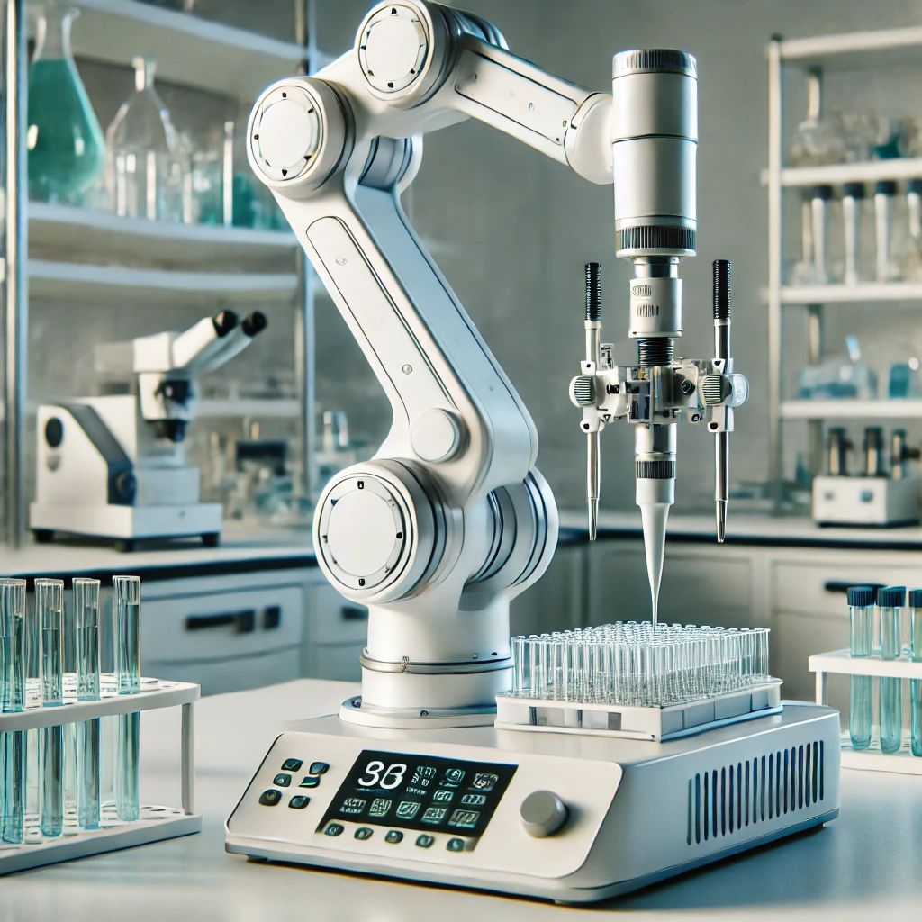
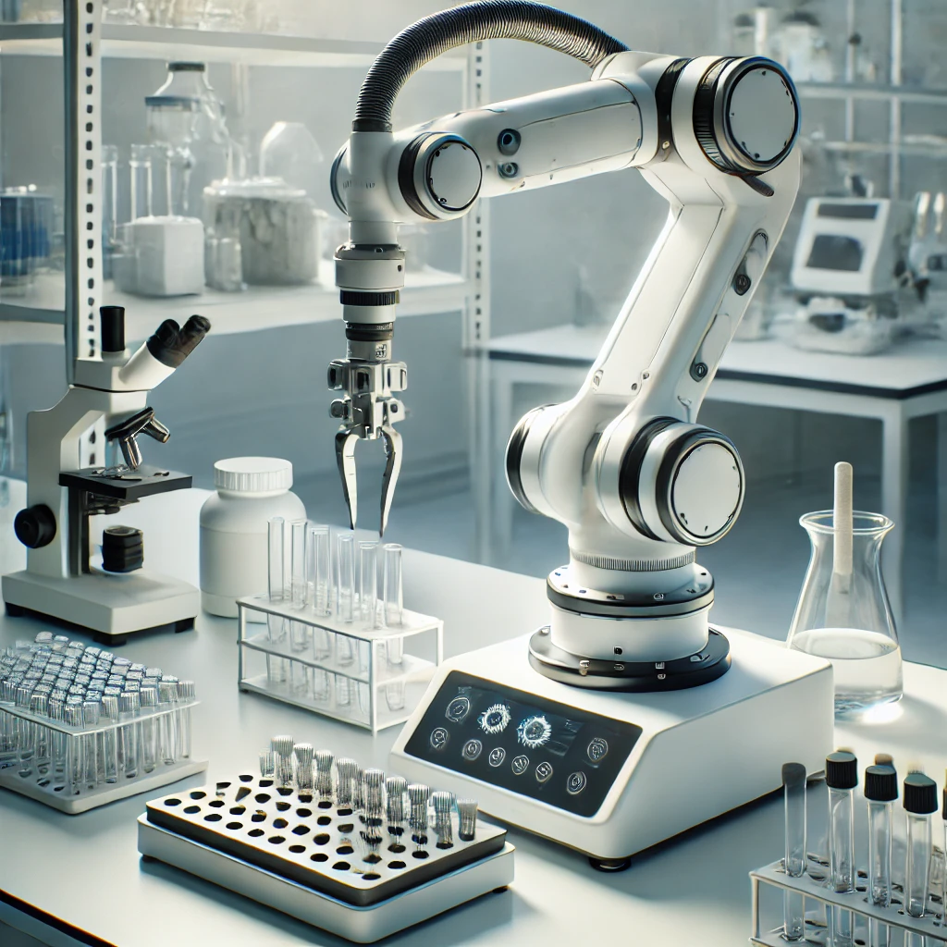
Solution Selection
Liquid Handling Workstation
  High Cost, unable to pick/place
Pneumatic Pick-and-Place System
  Unable to do pipetting
High-throughput Screening System
  Complex and expensive
Manual Labor
  Human error, Expensive
Robotic arm
  Fulfills all functions, less expensive, easy to use and less complex

Slide 9
Technical Decisions: Subsystem Partitioning
Power Management Subsystem
  Reception, distribution, and transforming of power in the system.
Manipulator Subsystem
  Control and movement of samples, as well as taking required data on the samples as needed.
Embedded Controller Subsystem
  Controls the robot’s movements and communicates with the lab equipment to receive and send information.
Physical Architecture Subsystem
  Physical resistance, weight, and stability of the robot’s main body and mounting hardware.
Notes:
Divided up by physical group, embedded controller– gather data, man
Divided up functionally, makes it easier to trace back how our system fulfills the requirements our stakeholder had

Slide 10
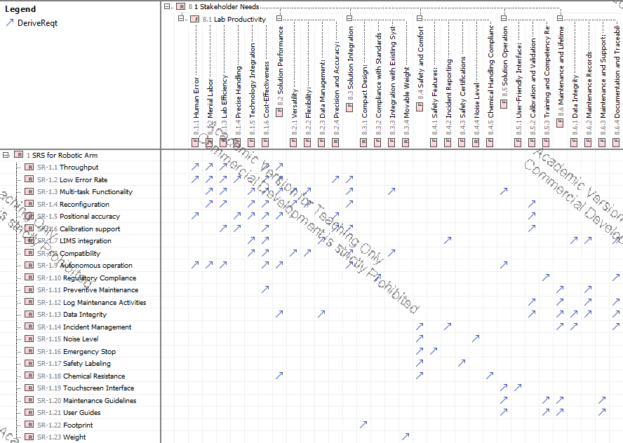
Requirements Matrix- Fulfillment of all requirements

Slide 11
Verification Plan: How do we know a solution that meets requirements will satisfy the stakeholders
Functional Requirements: Verification through performance of system via prototypes and software simulations.
Non-functional Requirements: Verification through calculations of subsystem performance.
  Ex) System noise requirements - added noises from each subsystem. Subsystem noises estimated based on research into comparable systems. Multiple values combined to be less than the 60dB requirement threshold.

Slide 12
Overall Team Process
Project took around 50 hours to complete
Work was done in two ways
  Done together while on call with each other
  Individually done based on time available
Members could bring in technical experience
  A team member has worked in a laboratory environment
  A team member worked with robots similar to a robot arm

Slide 13
Thanks for listening!

